Slide 1
Feature extraction for audio
Intermediate seminar presentation (AML-R)
Marcus Cramer

Slide 2







We use an (adjusted) version of the crisp-DM framework for data mining
SOURCE
Business Understanding
Data Understanding
DATA
Data Cleaning
Deployment
Modeling
Evaluation

Slide 3
We use an (adjusted) version of the crisp-DM framework for data mining
Business Understanding
Data Understanding
DATA
Data Cleaning
Deployment
Modeling
Evaluation

Slide 4

Agenda
Data understanding
Data cleaning
Value imputation
Machine learning approaches
Results
Source: https://learnvest.global.ssl.fastly.net/wp-content/uploads/2014/04/Roadmap.jpg

Slide 5

The available train dataset is huge; and the test set is just as big
1,932 features (completely anonymized)
Numerics
Strings
Binary target
145,231 obeservations
Factors
NAs
Dates
The immense size of the dataset and the variety of anonymized features makes qualitative analysis impossible.

Slide 6
Different attribute types must be handled seperately
No of categoricals update
Number of attributes per attribute type

Slide 7
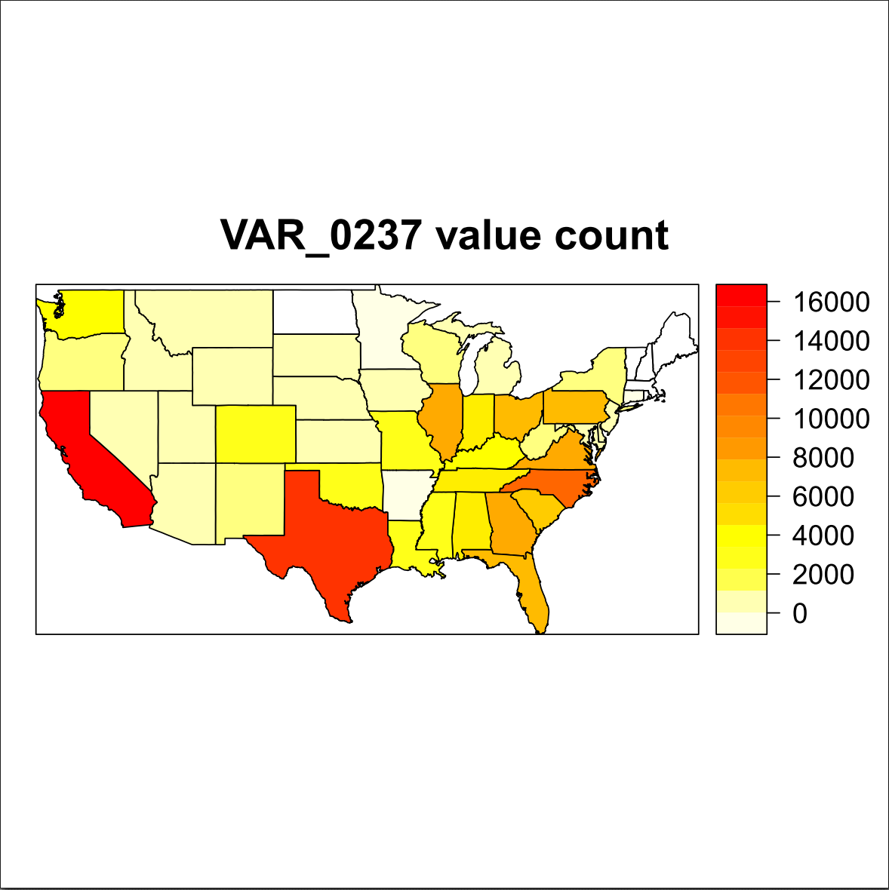
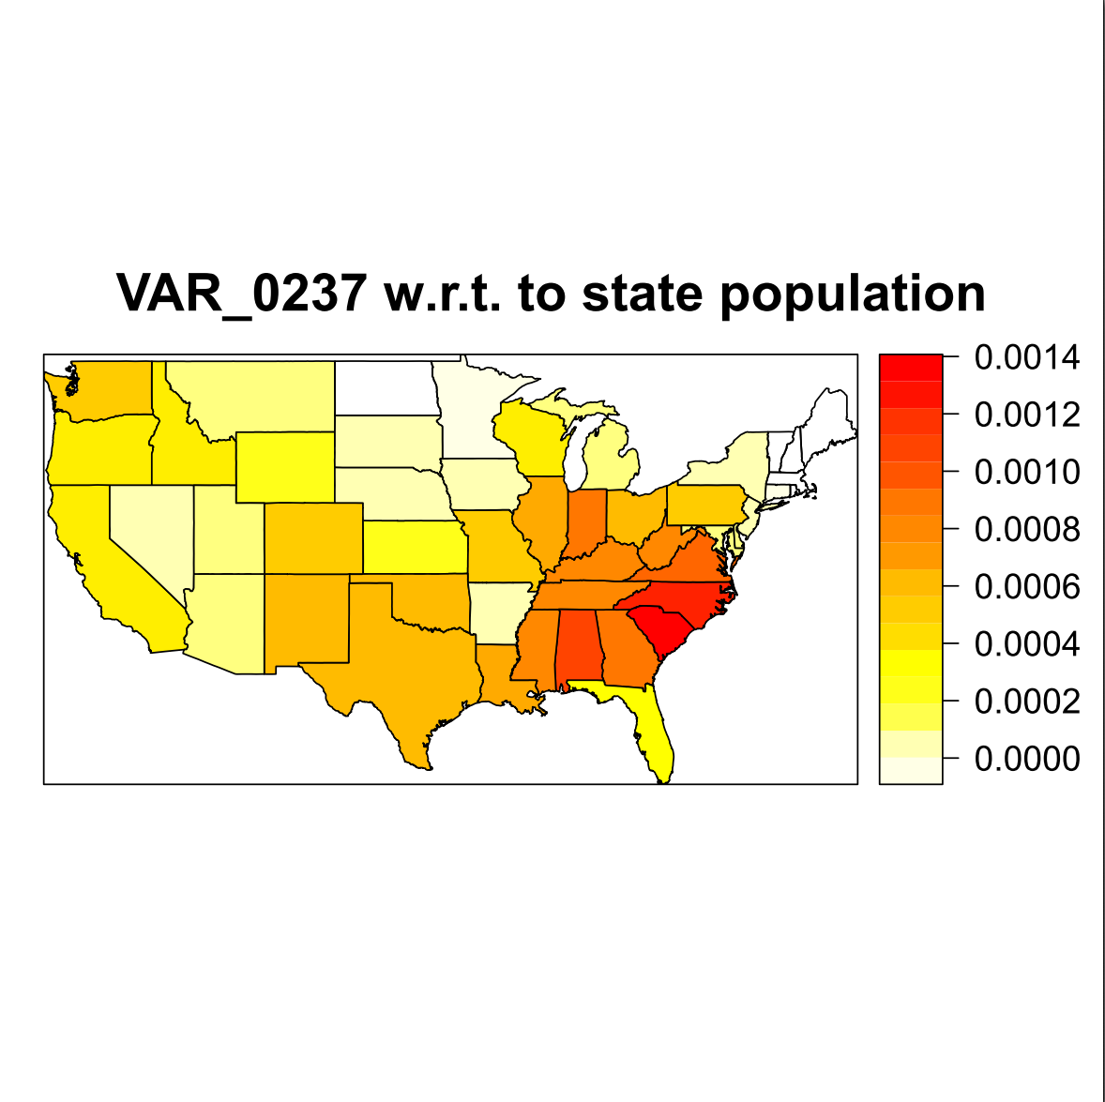
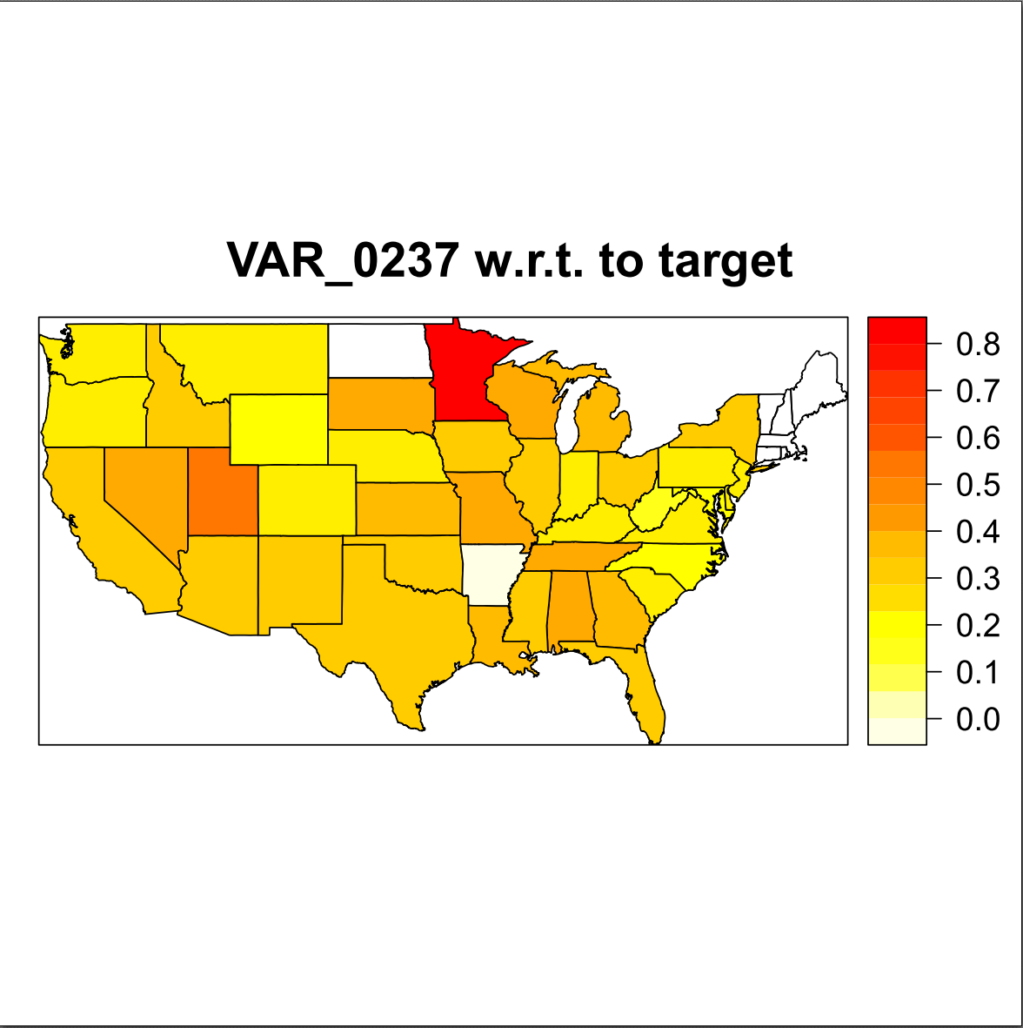
Numbers vary drastically among us states
Occurrences of US states
Occurrences w.r.t population
Target response rate

Slide 8
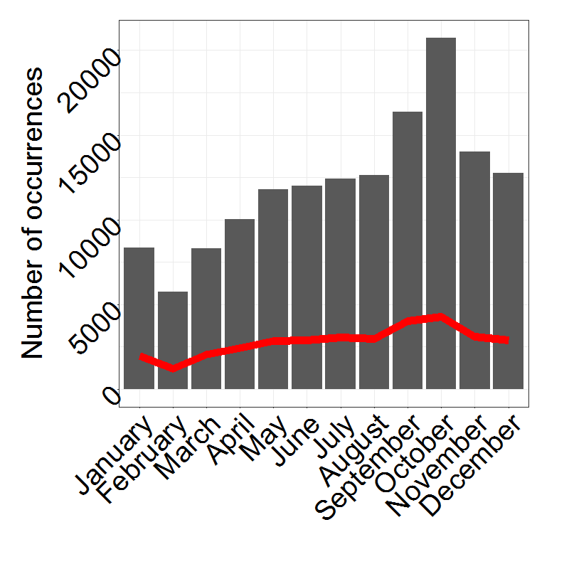
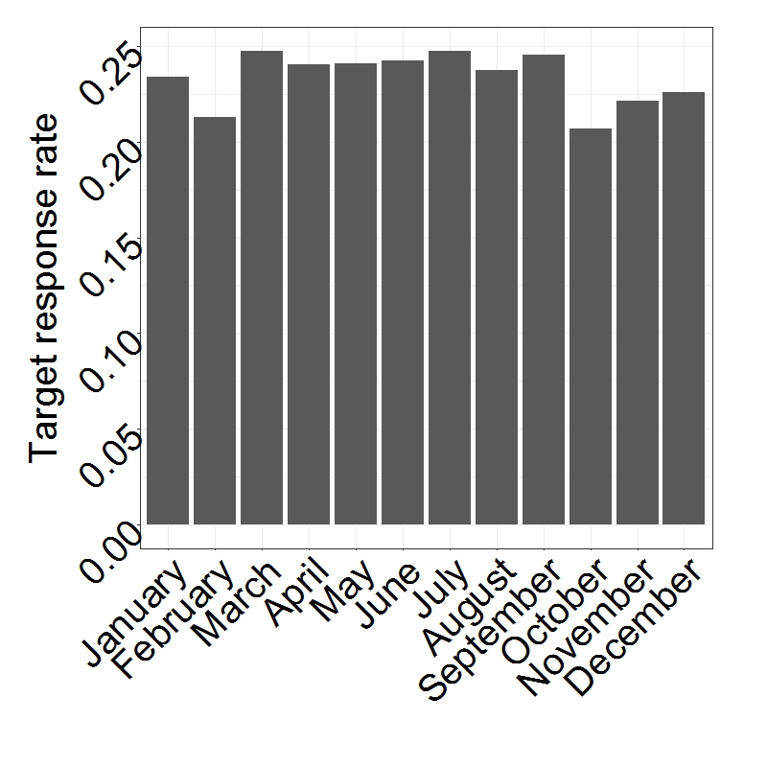
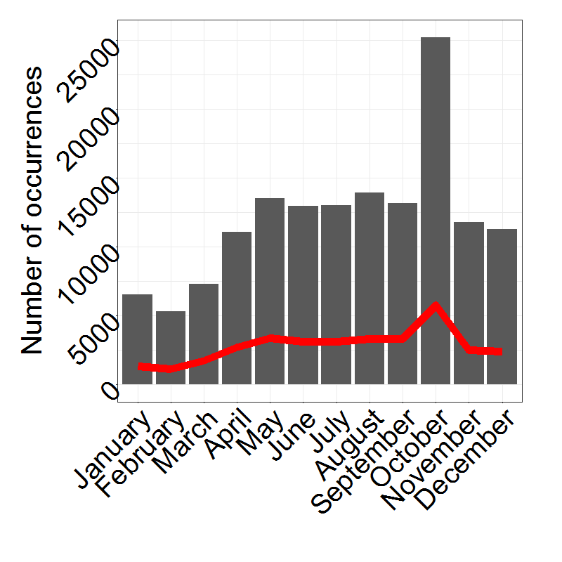
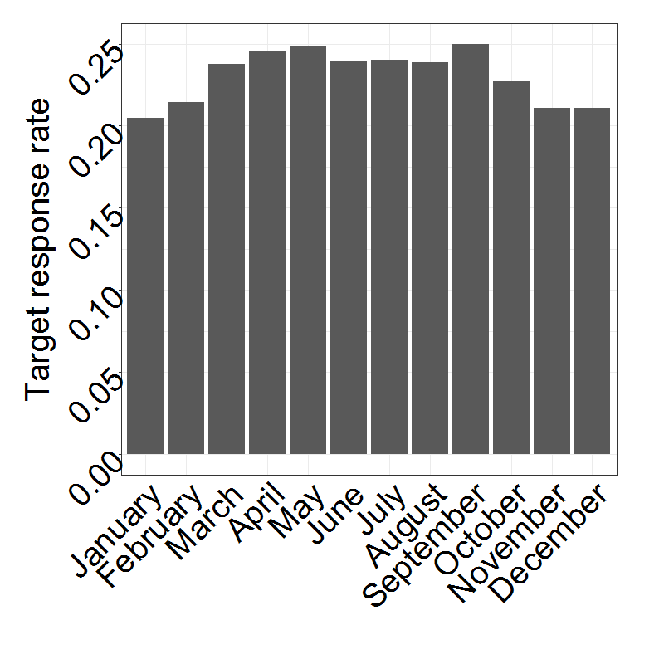
Numbers vary drastically For different months
Occurrences of months (2/16 features)
Target response rate of months

Slide 9
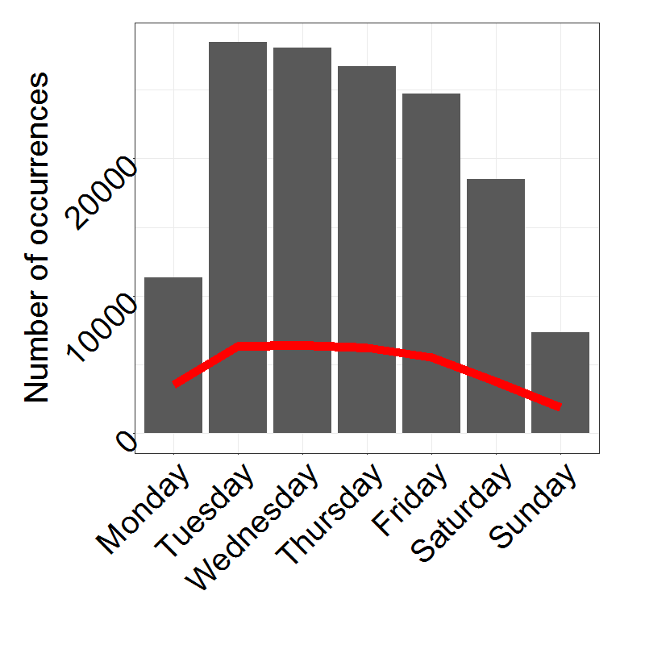
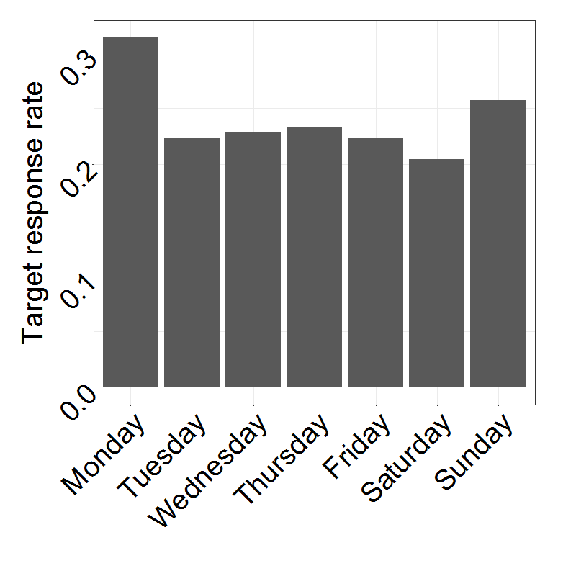
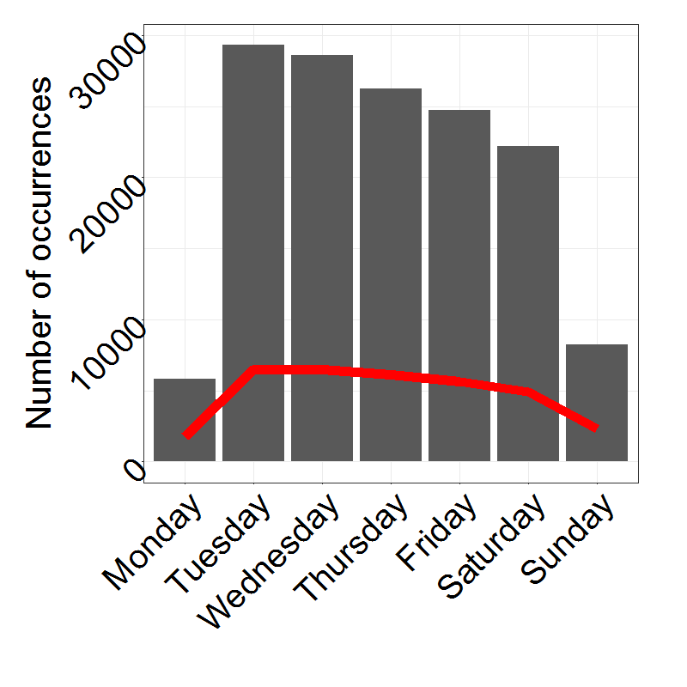
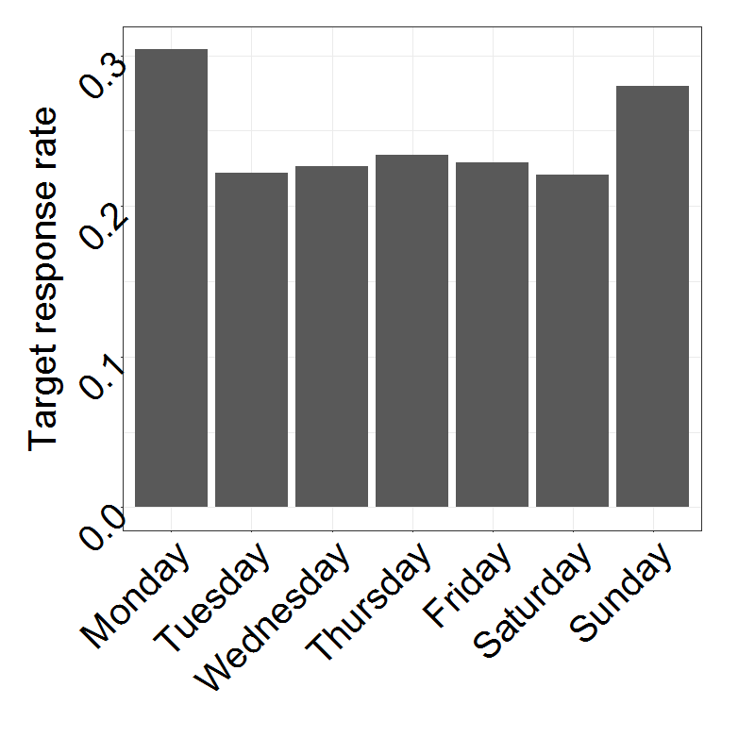
Numbers vary drastically FOR different Days
Occurrences of days (2/16 features)
Target response rate of days

Slide 10
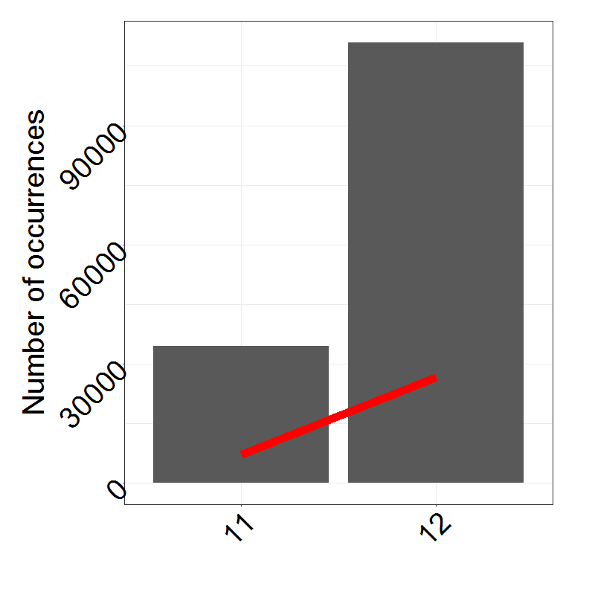
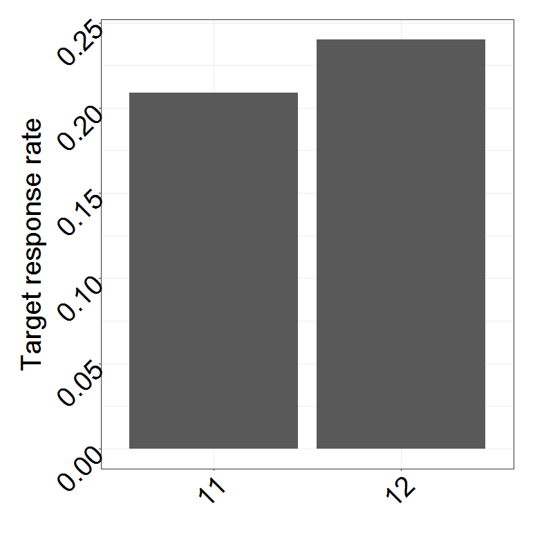
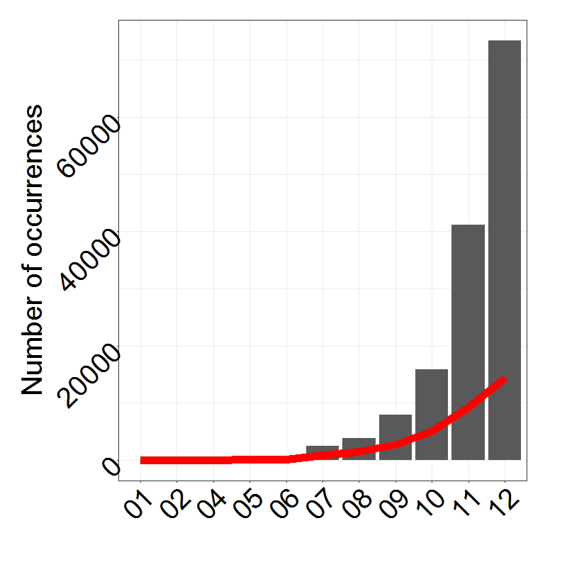
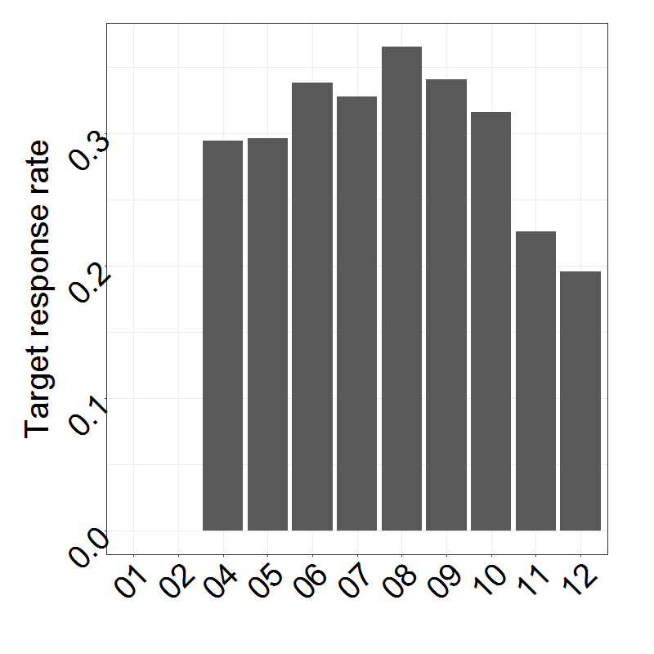
Numbers vary drastically FOR different Years
Occurrences of years (2/16 features)
Target response rate of years

Slide 11

Agenda
Data understanding
Data cleaning
Value imputation
Machine learning approaches
Results

Slide 12
Beautify
Different NA encodings
Obvious NAs: -1 (all other values positive), [], blank
More sophisticated:
Find columns with negative mean of unique values and remove outliers -> results in positive mean of unique values -> outlier = -99999 -> NA encoding
Take mean of unique values and mean of unique values minus one extremum on both sides -> if first value is more than 10 times higher than second value, we probably have an illogically high maximum value -> this is the case for 1+e09, 9999, 99, 100
Sometimes, the second highest value also seems to be some sort of NA encoding (same approach as above but removed second maximum too) -> 9996, 9998, 98
For other columns, a couple of extreme outliers exist. The maximum of extreme outliers is 5 values, which are more than 10000 times higher than the rest in the same column -> 999999999, 999999998, 999999997, 999999996, 999999995, 999999994
Everything double checked for plausibility with random manual samples
Made sure that data is unlikely to be factors (then these encodings might stand for sensible values)

Slide 13
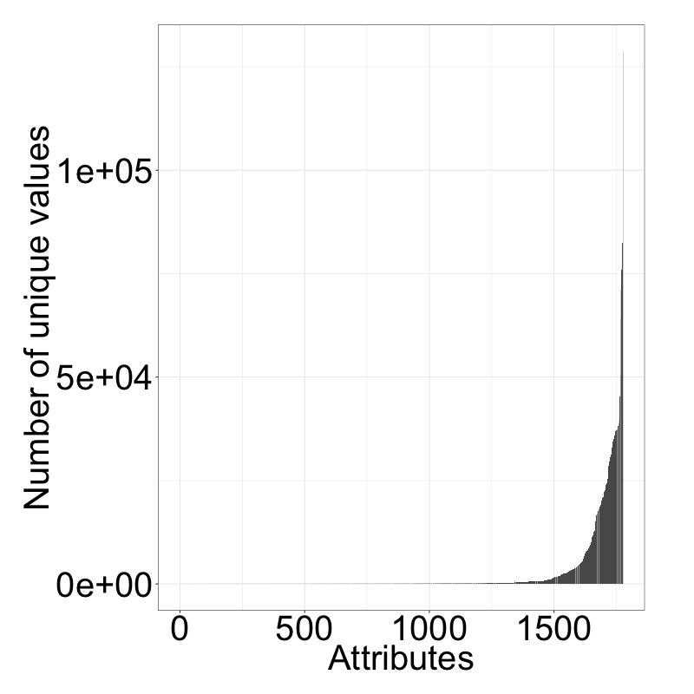
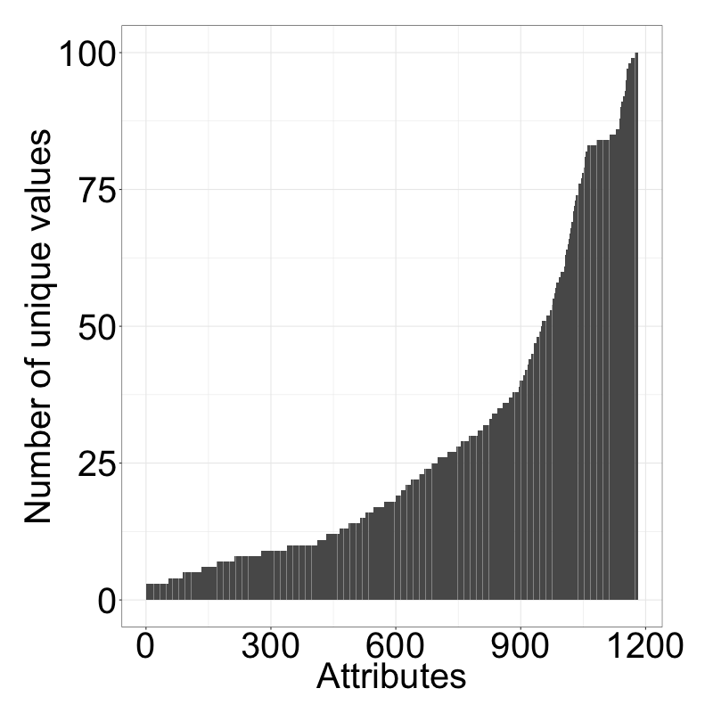
Numerical/categ. values hard to differentiate via “elbow-criterion”
Number of unique values per attribute
Number of unique values (<101)

Slide 14
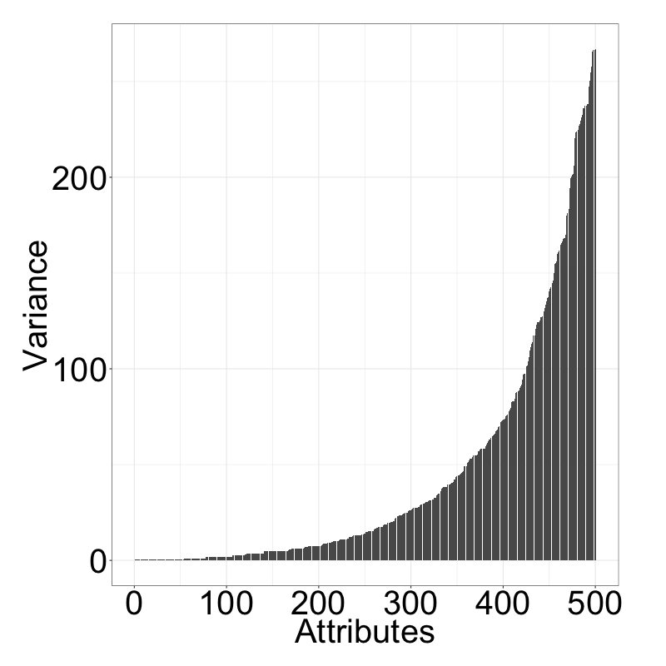
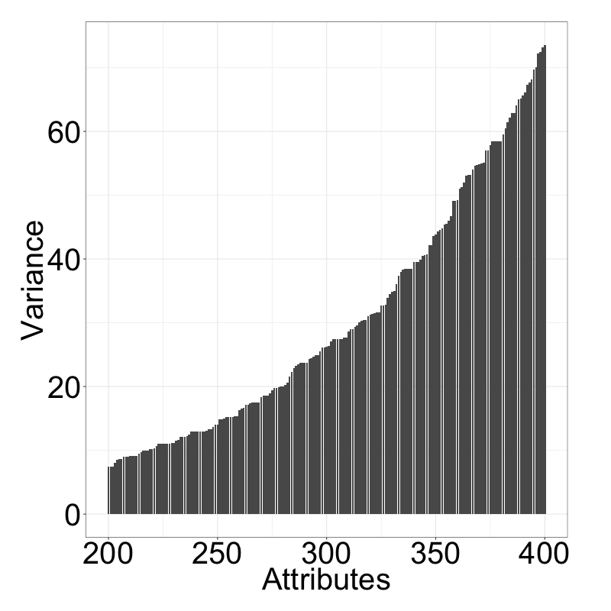
Elbow criterion applied to variances of unique values more insightful?
Var. between unique values (lowest 500)¹
Var. between unique values (200-400)
Elbows?
Elbow?
Highest difference between the 357. and the 358. attribute. We therefore assume, that the attributes 1-357 (sorted by variance) are candidates for categorical attributes.
1) Where the number of unique values is less than 101

Slide 15
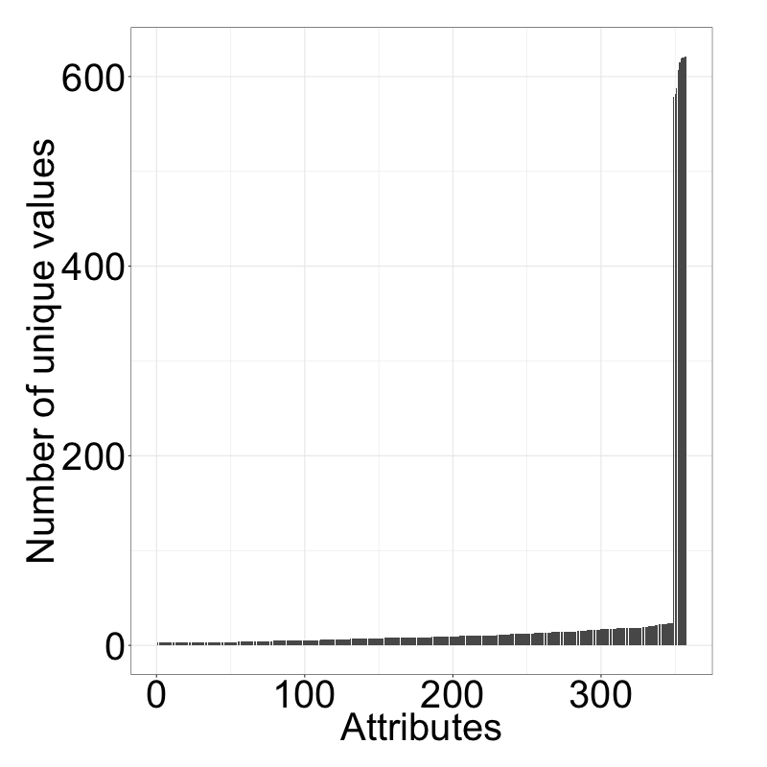
Reapplying this to the number of unique values reveals drastic elbow
Number of unique values per attribute
Highest gap between 348 and 349, it seems reasonable that out of the 348 attributes with the lowest variances, the attributes with the lowest number of unique values are categorical. All these attributes have less than 23 unique values.
Elbow
We identified 348 attributes, that are likely to be categorical. This is just a rough estimate, however, as the meaning of attributes is unknown.

Slide 16
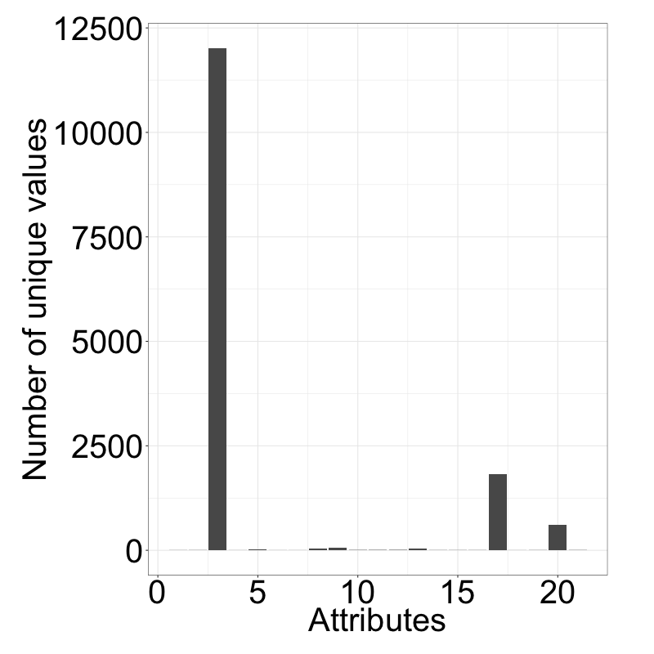
Number of unique values for strings differs greatly
Number of unique values per attribute
Too detailed, high chance of overfitting (and already included in US states)
Cities
Too detailed, high chance of overfitting)
US states
Job descriptions
99.99% NA values
We identified 348 attributes, that are likely to be categorical. This is just a rough estimate, however, as the meaning of attributes is unknown.

Slide 17
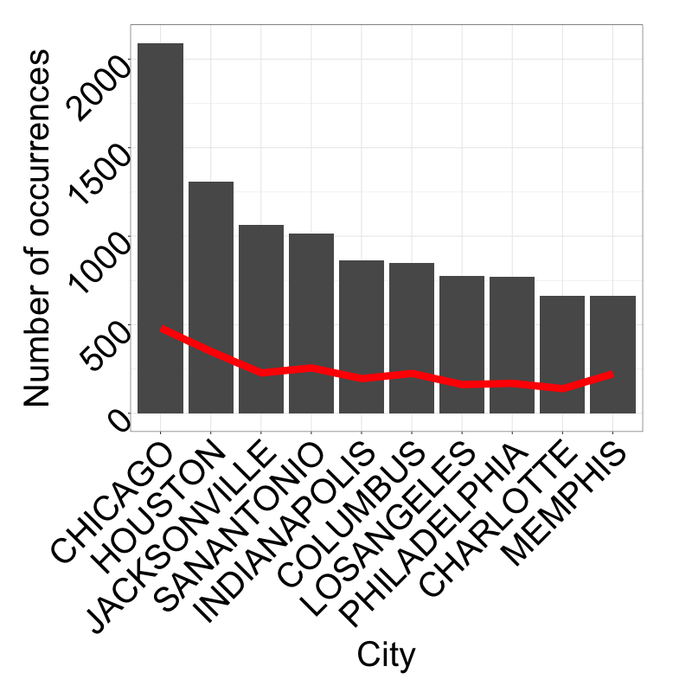
No city really stands out in terms of total occurrences

Slide 18
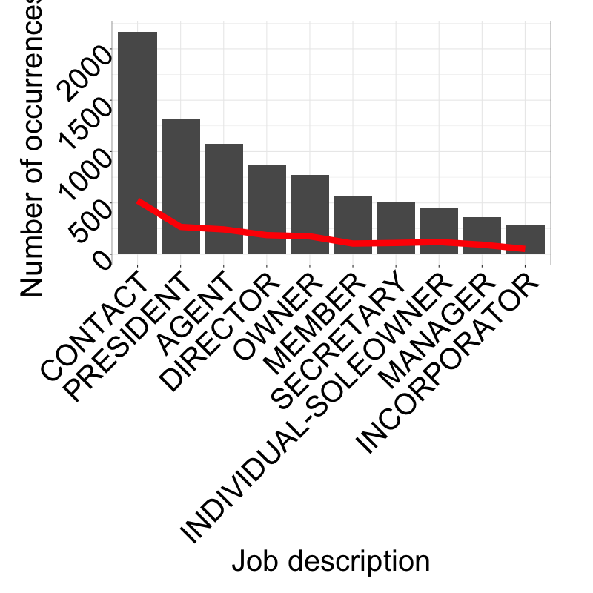
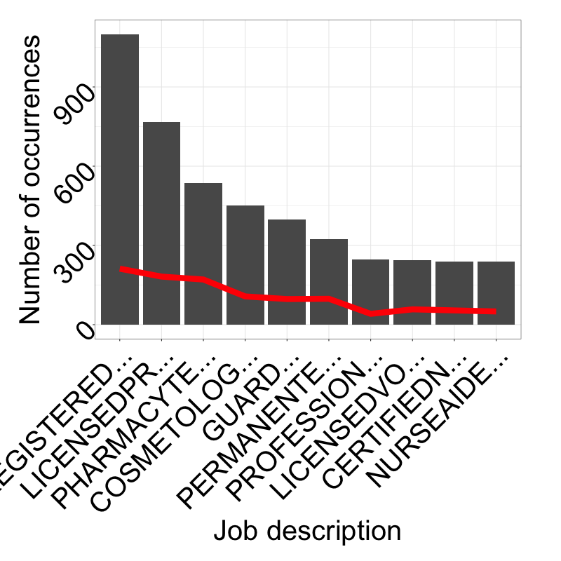
No Job description really stands out in terms of total occurrences

Slide 19
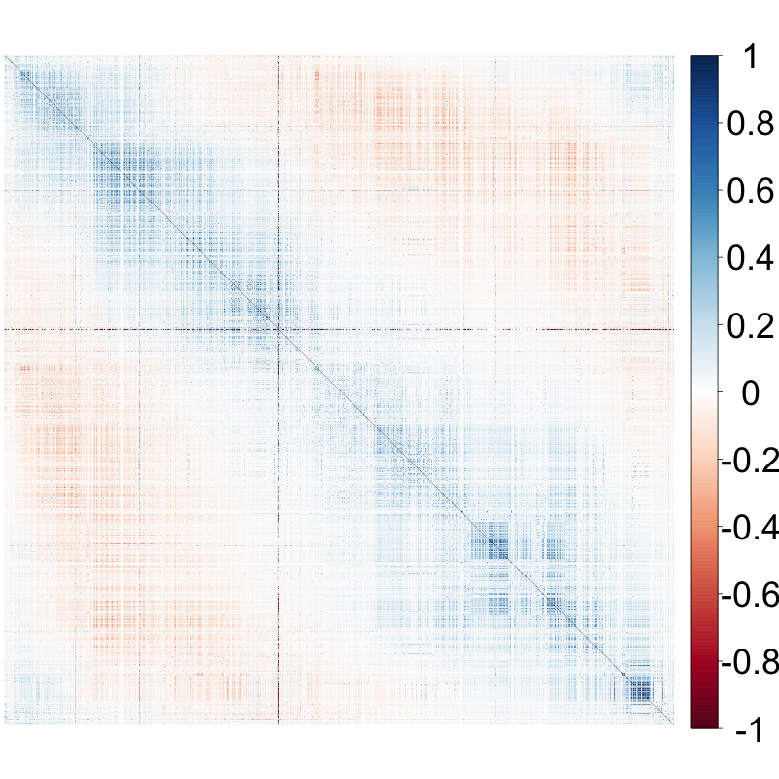
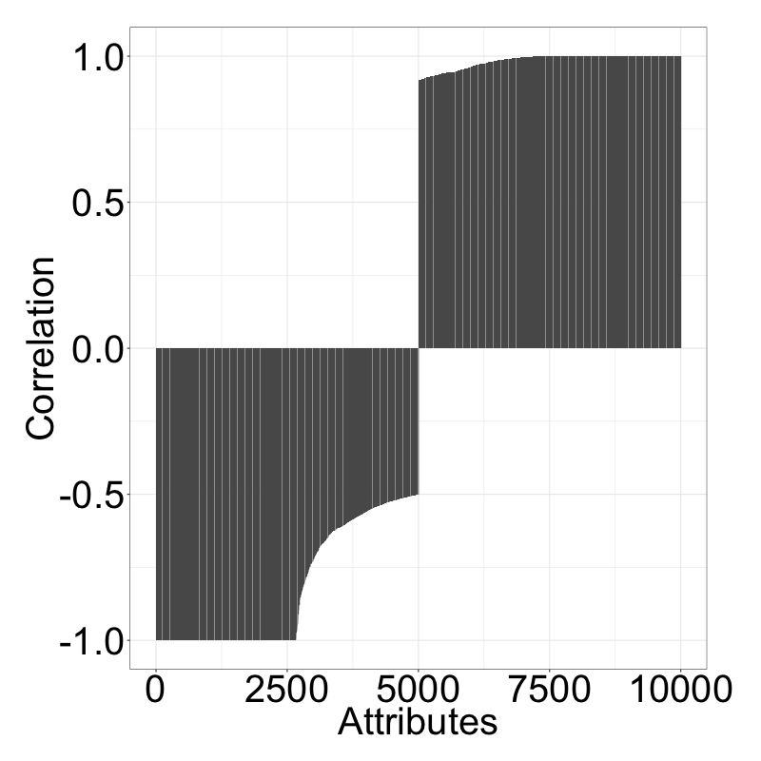
Attributes are fairly uncorrelated according to pearson coef.
Correlations between all atts. (ordered)
5000 lowest and highest correlations

Slide 20
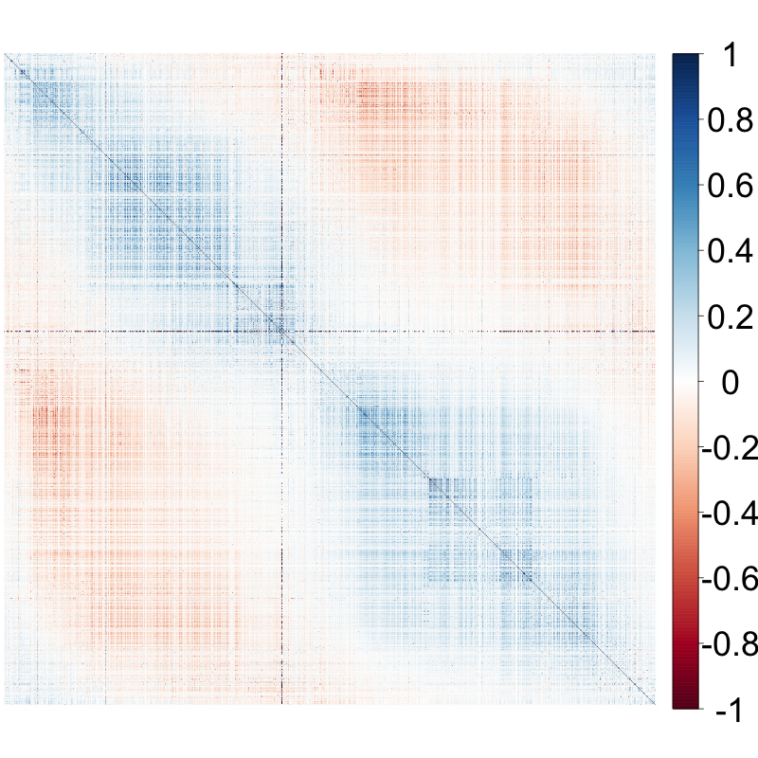
Spearman reveals higher correlation according to rank of att. values
Correlations between all atts. (ordered)
5000 lowest and highest correlations
45 entries with a correlation of 1 and 13 entries with a correlation of -1 could be identified (out of these 49 unique attributes). We can therefore remove these 49 attributes.

Slide 21
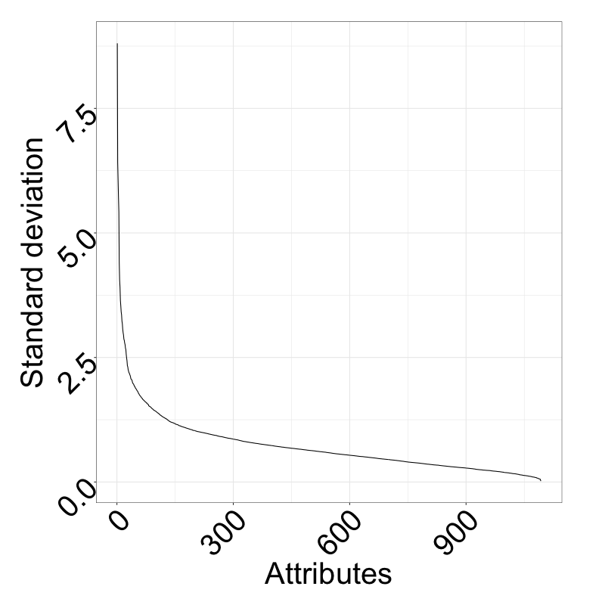
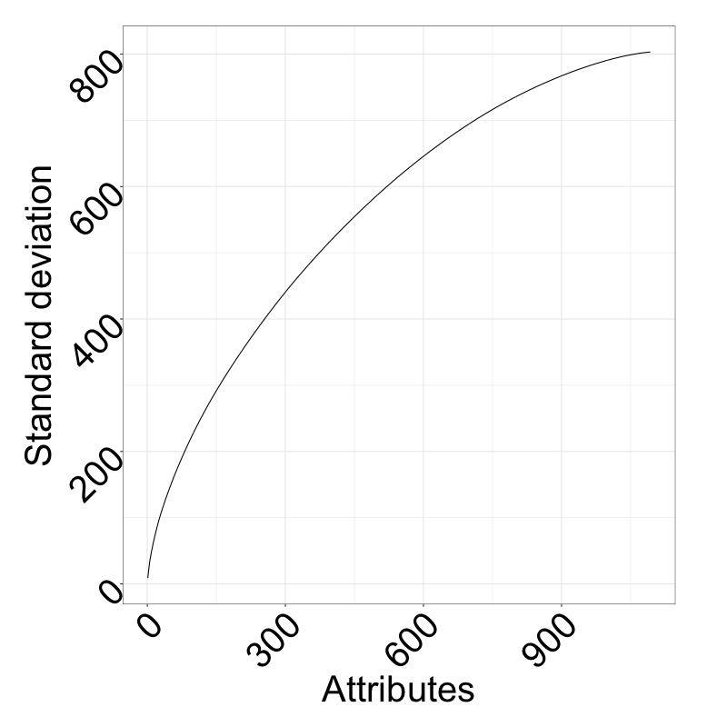
PCA reveals steep curve; however, no distinct elbow can be identified
Explained variance by PCs
Cumsum of variance of PCs
The first 600 PCs explain more than 80% of the variance; decreasing the dimensionality might be utilized for performance improvements.

Slide 22
Agenda
Data understanding
Data cleaning
Value imputation
Machine learning approaches
Results

Slide 23
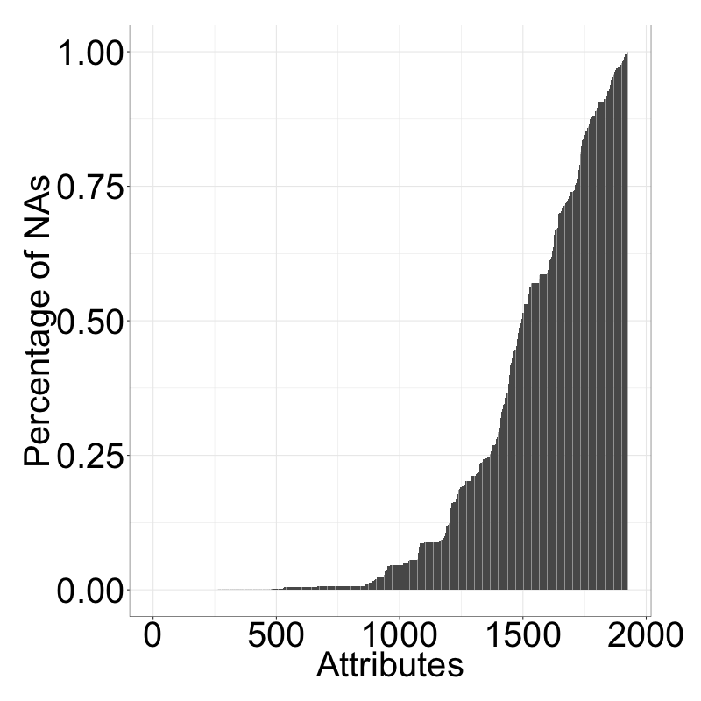
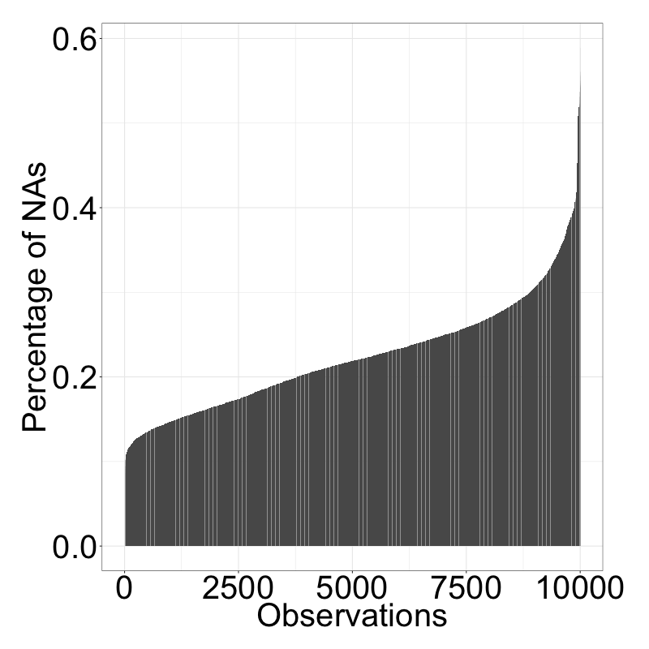
Number of Nas varies a lot per attribute and observation
NA values per attribute in %
NA values per sample in %

Slide 24
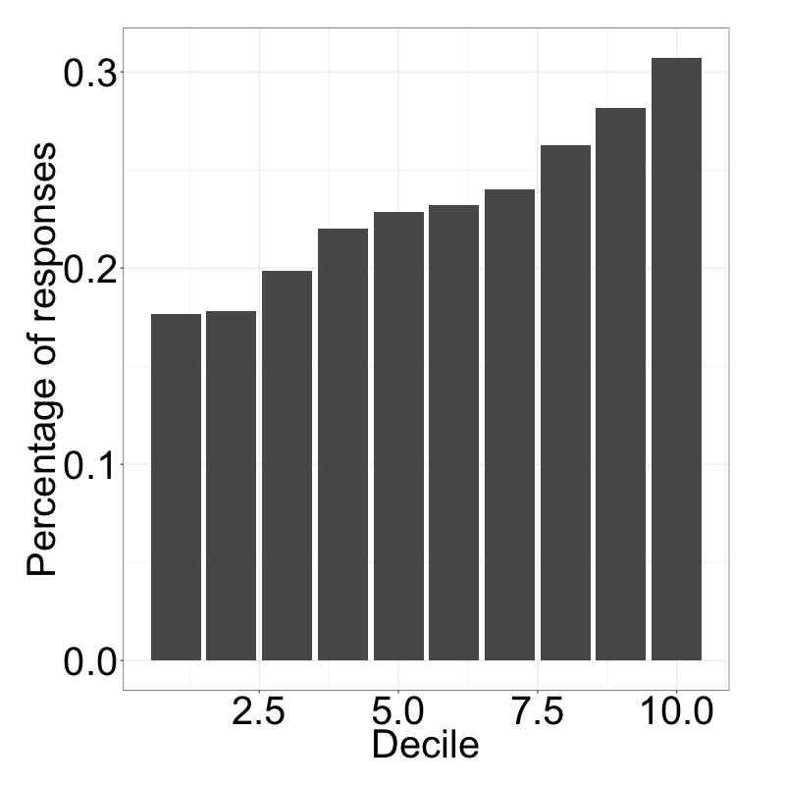
Completeness of observation highly impacts target variable
Incompleteness of sample

Slide 25
MICE imputation fastest but does not run on the dataset
Imputation with similar NA structure
Attribute B
NA
NA
3
10
NA
4
5
1

Slide 26
MICE imputation fastest but does not run on the dataset
Imputation with similar NA structure
Attribute A
Attribute B
1529
1002
NA
NA
141
NA
NA
174
NA
NA
3
10
NA
4
5
1
X

Slide 27
MICE imputation fastest but does not run on the dataset
Imputation with similar NA structure
Attribute A
Attribute B
Attribute C
1529
1002
NA
NA
141
NA
NA
174
NA
NA
3
10
NA
4
5
1
0
9
4
NA
4
NA
9
0
X

Slide 28
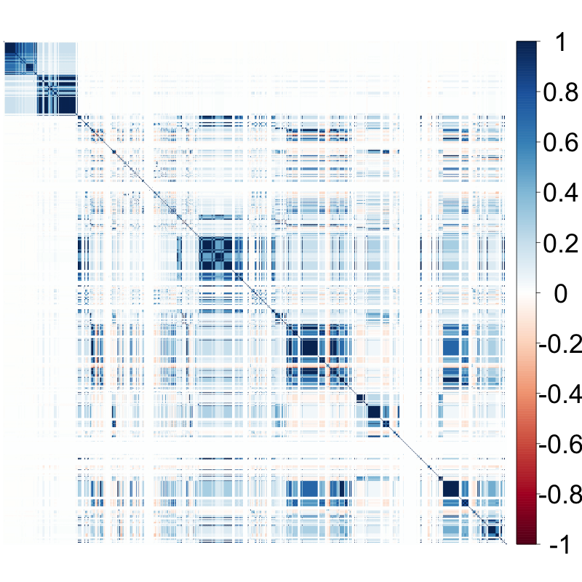
MICE imputation fastest but does not run on the dataset
Imputation with similar NA structure
Missingness correlations
Attribute A
Attribute B
Attribute C
1529
1002
NA
NA
141
NA
NA
174
NA
NA
3
10
NA
4
5
1
0
9
4
NA
4
NA
9
0
X
Many closeby variables have the same missingness patterns. Apparently, data was collected in chunks or split up later. This is problematic for our imputation.

Slide 29
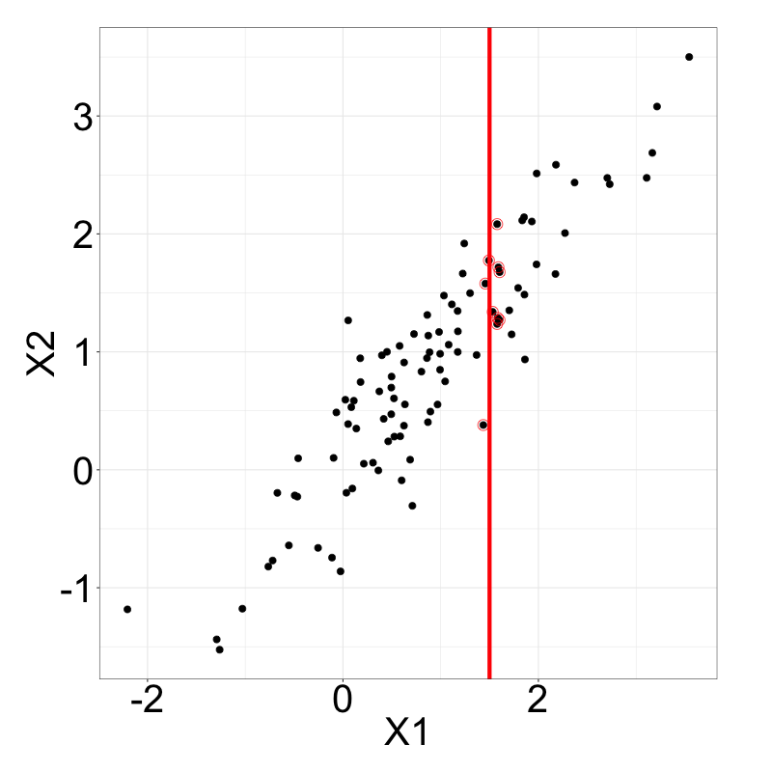
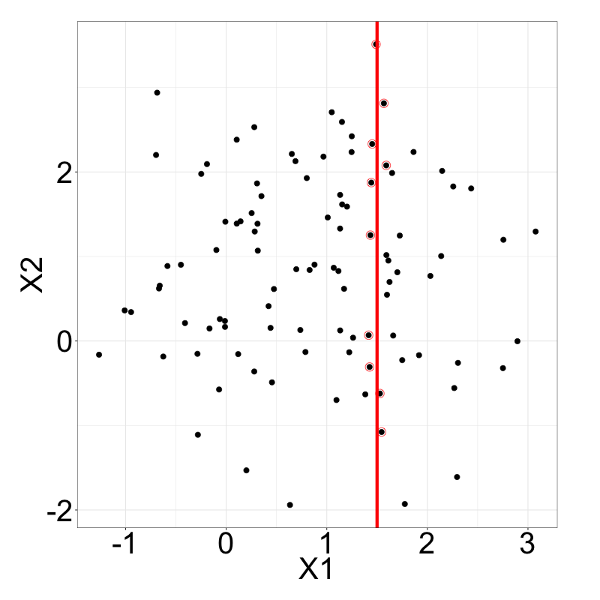
variables should show correlation and not equal missingness patterns
Multivariate random samples (cor = 0.9)
Multivariate random samples (cor = 0)
candidates
candidates
For imputation, we select the top five variables in terms of correlation, that have a missingness correlation of lower than 0.7.

Slide 30
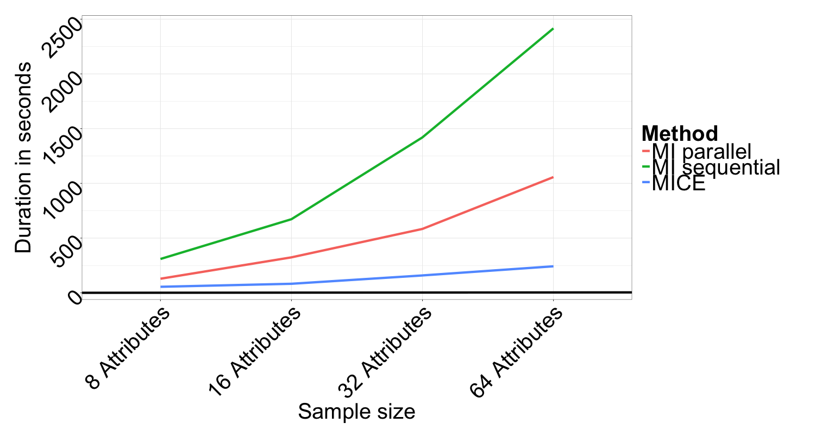
MICE imputation fastest but does not run on the dataset
MICE clearly the fastest, but unfortunately fails for some attributes (-> fails for the whole computation)
MI also fails for some but can be divided per attribute
Own parallel implementation of MI faster than MI, so this was taken for imputation

Slide 31
Agenda
Data understanding
Data cleaning
Value imputation
Machine learning approaches
Results

Slide 32
Publications on big data in the last five years
Source: Scopus keyword search; inspirations from Al-Jarrah et al. (2015), Berral-Garcia (2016), Gupta et al. (2016), Qiu et al. (2016), Richter et al. (2015), Sharma et al. (2013)

Slide 33
Used machine learning techniques
Logistic regression, svms, anns, kknn were tested and discarded due to performance or input data reasons
RPART | Random Forest | Xtreme Gradient Boosting
Tree-based model
Basic method | Ensemble method
Grows tree and prunes | Grows deep trees | Grows one tree per round
Fit a single tree | Fit many independent trees | Iterative model improvement
Predict by leaf | Predict by majority vote | Predict by latest model iteration

Slide 34



On Decision trees
sex=male
A tree visualizes a set of binary rules
An observation will end up in a leaf, which assigns its class to the observation
Algorithms usually work top-down, by choosing at each step the variable that best splits the observations
Likes gaming
age<14
Likes gaming
Doesn’t like gaming
Trees tend to grow very deep, which results in overfitting.
…
Countermeasures:
Subsampling columns
Subsampling rows
Pruning

Slide 35



Boosters convert weak learners to strong ones
Boosting algorithms fit iteratively weak learners of the same type
Learner 1
Next iteration focuses on previously misclassified data
Weighted Data
Learner 2
$$Σ$$
Adding up all learners with weights gives a powerful learner
Weighted Data
…
Gives state-of-the-art results on many standard classification benchmarks¹
Source: Li (2012)

Slide 36
eXtreme gradient Boosting (xgboost)
Popular boosting algorithm
How
Builds on Gradient Boosting Method, where “shortcomings” in previous learners are identified by gradients
Improves it through simplified tree building, pruning and parallel processing
Approximated splitting algorithm makes it faster
does it work?
Why
is it used?
Power
Speed
Customization
Chen, Tianqi, and Carlos Guestrin. "Xgboost: A scalable tree boosting system." arXiv preprint arXiv:1603.02754 (2016).
Notes:
Loss controls predictive power,
Complexity prevents overfitting

Slide 37
Agenda
Data understanding
Data cleaning
Value imputation
Machine learning approaches
Results

Slide 38
The area under curved can be used for visual performance evaluation
ROC curves visualize binary classification performance
The better a classifier, the closer its curve is to the top-left corner
The threshold of a classifier defines a point on the curve
AUC summarizes the performance and lies between 0 and 1
P(TP)
P(FP)
random guess
classifiers
Notes:
P(TP)=probability of detection, sensitivity
AUC is equal to the probability that a classifier will rank a randomly chosen positive instance higher than a randomly chosen negative one (assuming 'positive' ranks higher than 'negative')

Slide 39
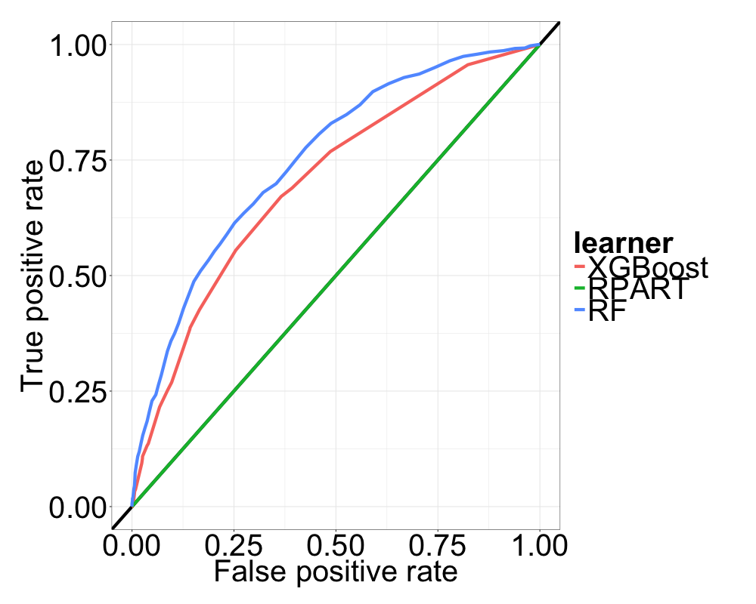
Random forest performs best on default settings
Default parameter setting makes RPART no better than random guessing
Random Forest beats XGBoost …but default iterations are 1
Random Forest
XGBoost
1.
RPART
2.
3.

Slide 40
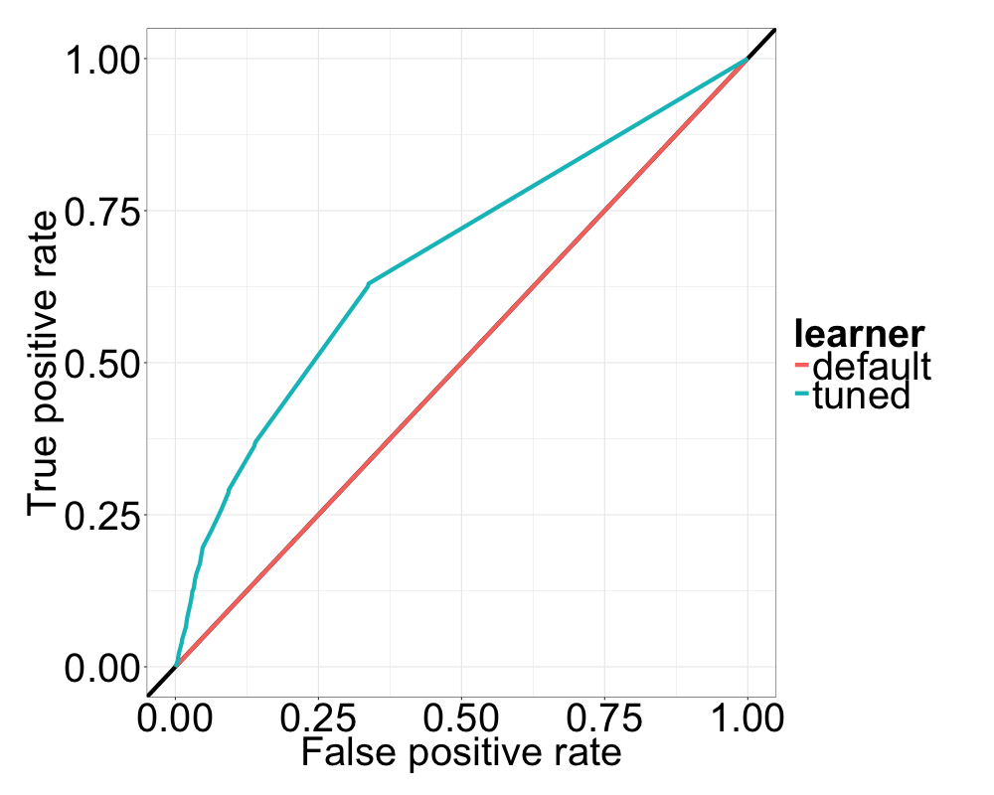
Parameter tuning for rpart
done
Tuning parameter significantly improves AUC for RPART

Slide 42
References
Al-Jarrah, Omar Y., et al. "Efficient machine learning for big data: A review." Big Data Research 2.3 (2015): 87-93.
Berral-García, Josep Lluis. "A quick view on current techniques and machine learning algorithms for big data analytics." Transparent Optical Networks (ICTON), 2016 18th International Conference on. IEEE, 2016.
Gupta, Preeti, Arun Sharma, and Rajni Jindal. "Scalable machine‐learning algorithms for big data analytics: a comprehensive review." Wiley Interdisciplinary Reviews: Data Mining and Knowledge Discovery 6.6 (2016): 194-214.
Qiu, Junfei, et al. "A survey of machine learning for big data processing." EURASIP Journal on Advances in Signal Processing 2016.1 (2016): 1-16.
Richter, Aaron N., et al. "A Multi-Dimensional Comparison of Toolkits for Machine Learning with Big Data." Information Reuse and Integration (IRI), 2015 IEEE International Conference on. IEEE, 2015.
Sharma, Seema, et al. "Machine learning techniques for data mining: A survey." Computational Intelligence and Computing Research (ICCIC), 2013 IEEE International Conference on. IEEE, 2013.
Li, Ping. "Robust logitboost and adaptive base class (abc) logitboost." arXiv preprint arXiv:1203.3491 (2012).

Slide 43
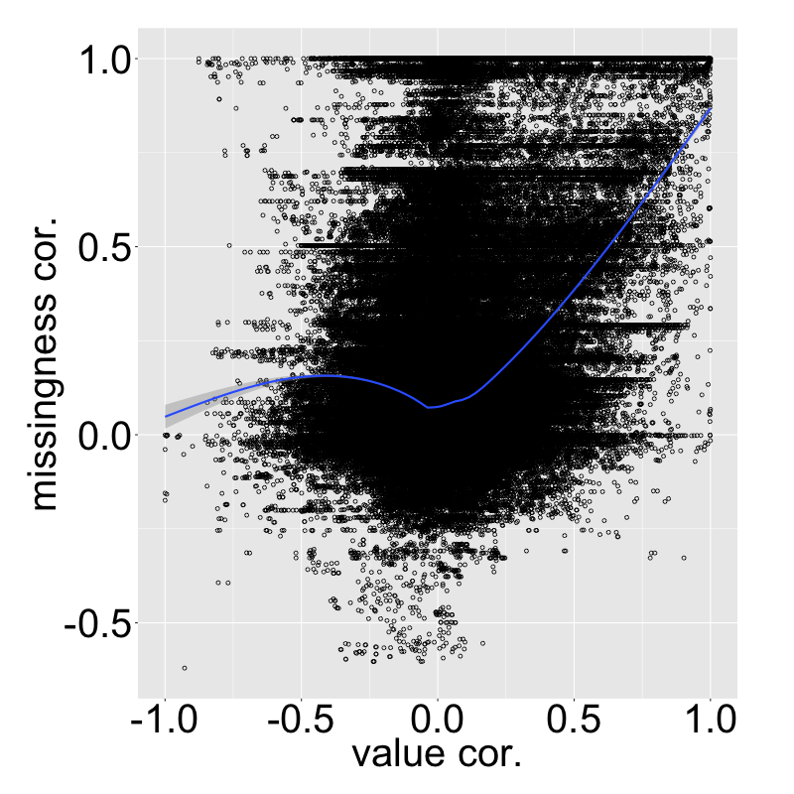
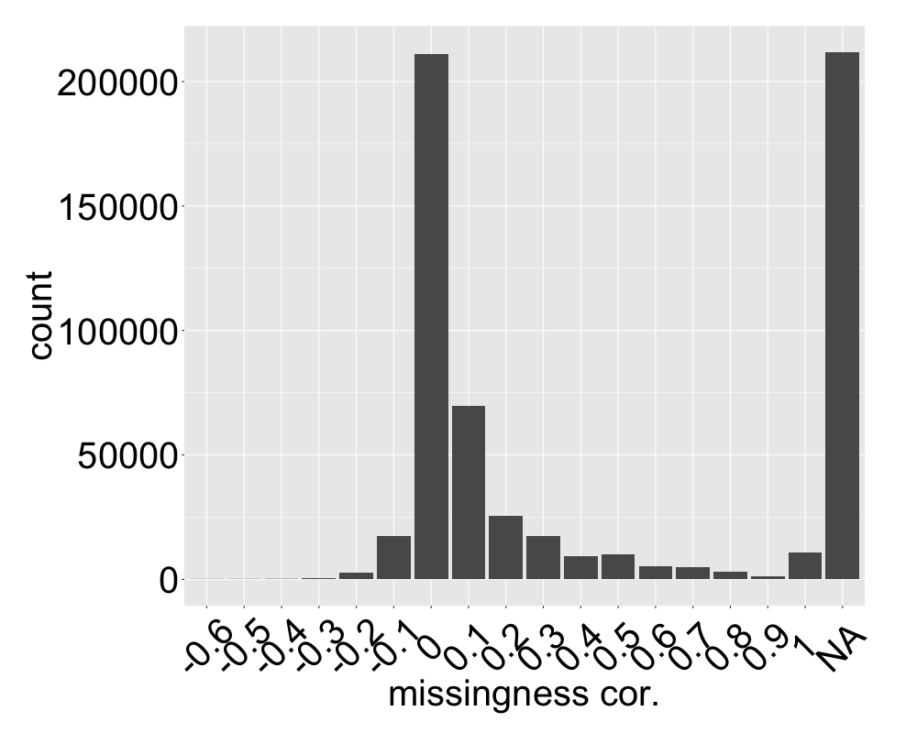

Slide 44





Some practical application fields
Speech
Nature sound
Sentiment analysis¹
Voice classification²
Automatic speaker recognition³
Speech to text systems⁴
Machine failure recognition⁶
Military sound analysis⁶
Animal sound recog-nition (e.g. birds)⁷
Music signal processing
Other
Genre identification⁵
Instrumentation⁵
Dynamics, tempo and timbre⁵
Medical hearing aid⁶
Adaptive noise cancelling⁶
Digital watermarking⁶
Source: 1) http://nlp.stanford.edu/sentiment/, 2) Pandya, Pathak (2014), 3) Kamruzzaman et al. (2010), 4) https://research.googleblog.com/2015/08/the-neural-networks-behind-google-voice.html,
5) http://signalprocessingsociety.org/uploads/special_issues_deadlines/MusicSP.pdf,
6) Perez-Meana (2007), 7) Stowell, Plumbley (2014)

